Slide 1


Chatting Application
Omar Ayman Saleh
Tareq Ahmad Mohamed
Salma Karam Elsaghier

Slide 2
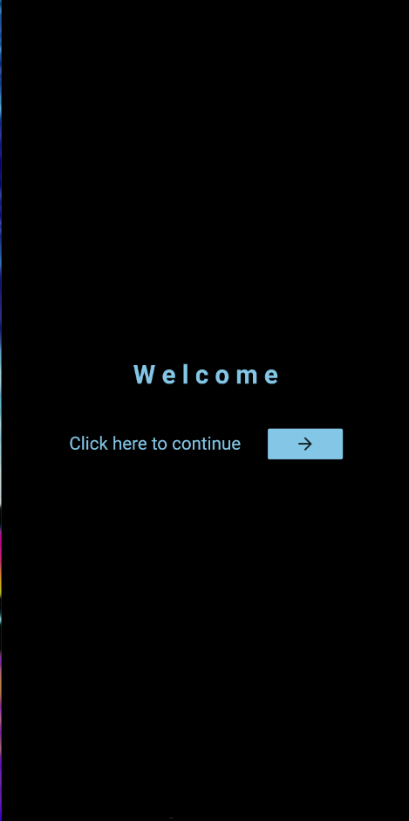
Welcome page
MaterialButton
Navigator
Push
MaterialPageRoute

Slide 3
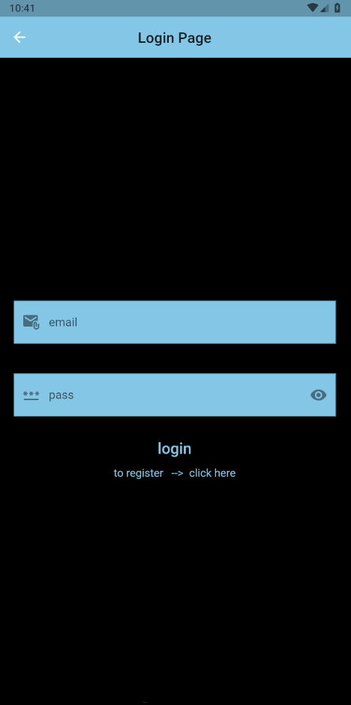
Login page
prefixIcon
I) hintText
Go to app
suffixIcon
onTap
obscureText
Go to register page

Slide 4
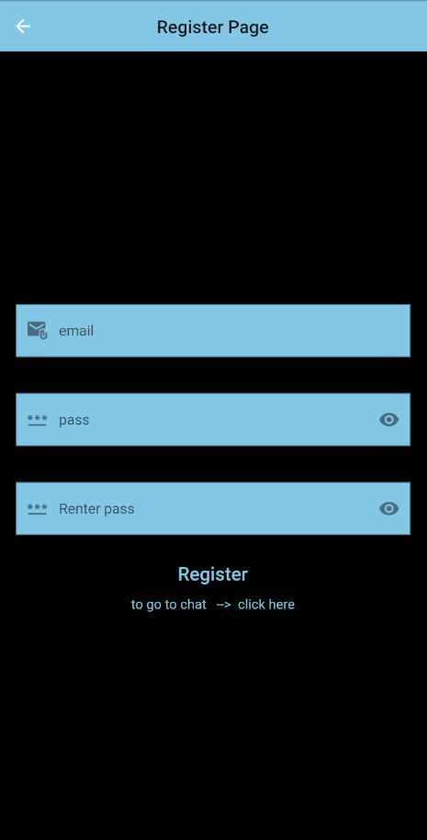
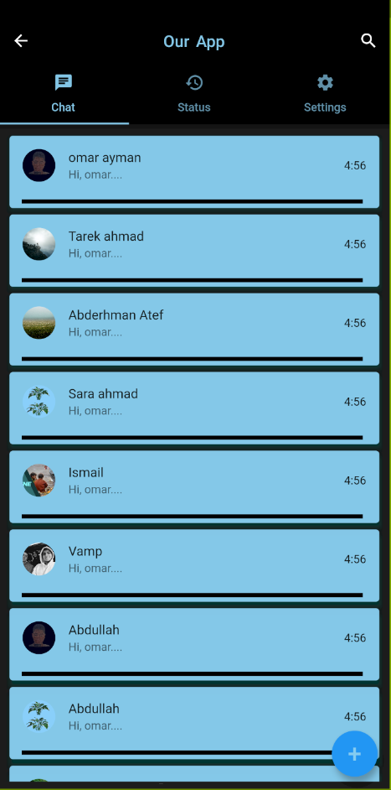
Icon(Icons.search)
bottom
TabBar
labelColor
indicatorColor
title
subtitle
trailing
Divider
leading
CircleAvatar
AssetImage
ListTile
onTap
MaterialPageRoute
Go to app
FloatingActionButton

Slide 5
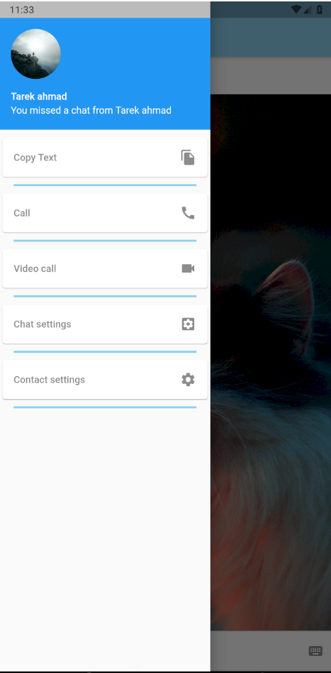
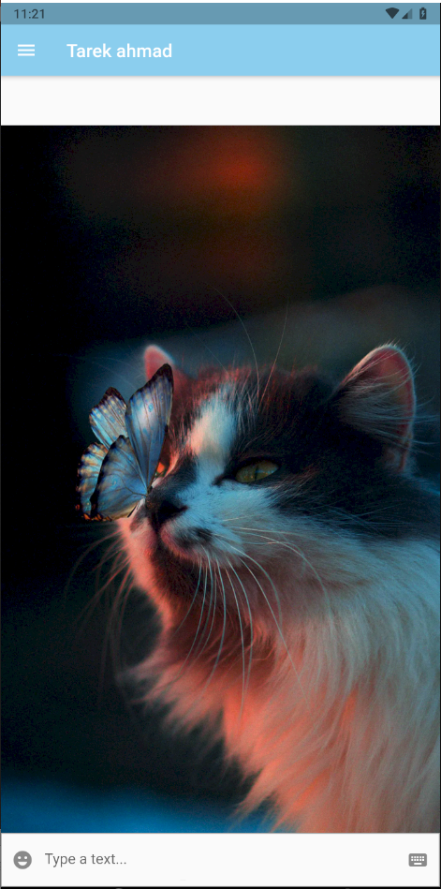
currentAccountPicture
Drawer
accountName
Card
Trailing
Icon(Icons.videocam)
Divider
title
TextFormField
To open the keyboard
To open the emoji keyboard

Slide 6
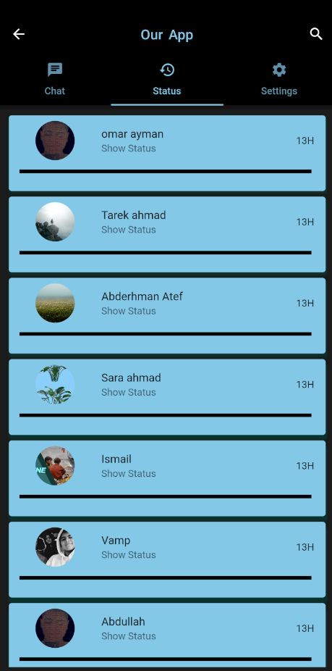
Status page
Icon(Icons.search)
bottom
TabBar
labelColor
indicatorColor
title
subtitle
trailing
Divider
leading
CircleAvatar
AssetImage
ListTile
onTap
MaterialPageRoute

Slide 7
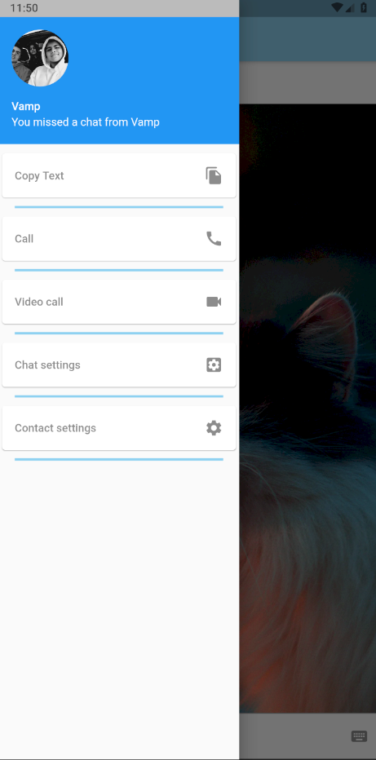

currentAccountPicture
Drawer
accountName
Card
Trailing
Icon(Icons.videocam)
Divider
title
TextFormField
To open the keyboard
To open the emoji keyboard

Slide 8
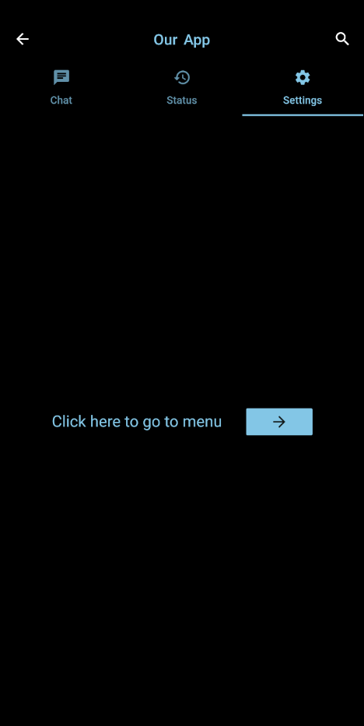
Settings page
Icon(Icons.search)
bottom
TabBar
labelColor
indicatorColor
MaterialButton
Navigator
Push
MaterialPageRoute

Slide 9
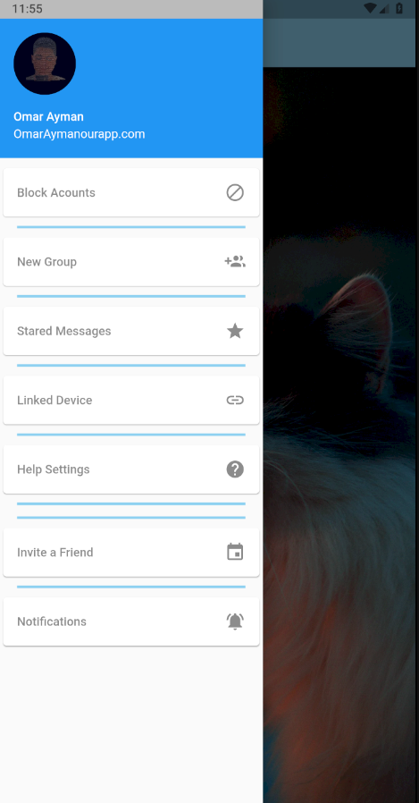
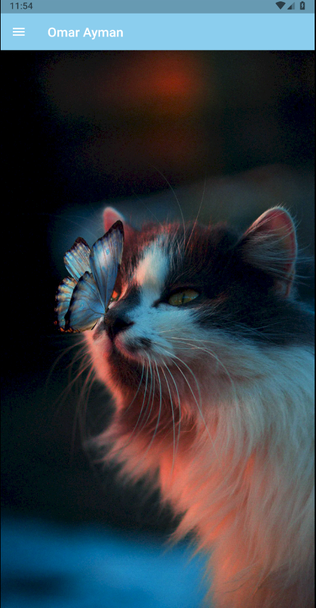
currentAccountPicture
Drawer
accountName
accountEmail
Card
Trailing
Icon(Icons.star)
Divider
title

